Slide 1

Secure Blog Application Overview
This presentation covers the program's aim, operation, technologies, security, testing, and AI usage.
Bg
by Balkrishna giri

Slide 2

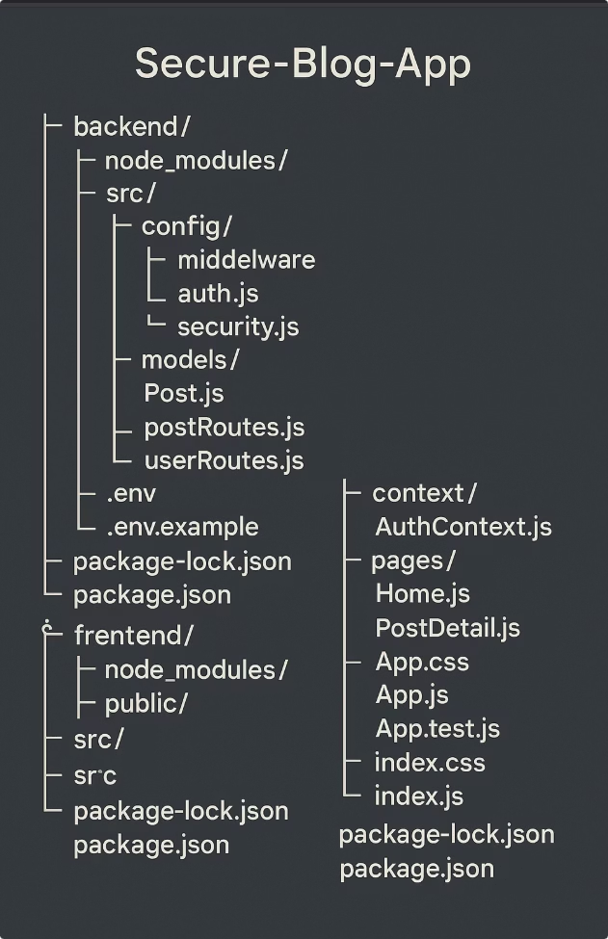
Aim of the Program
The program aims to provide a secure and functional blog application where users can safely create, view, edit, and delete posts, with strong management of authentication and user authorization to ensure security at every step.

Slide 3
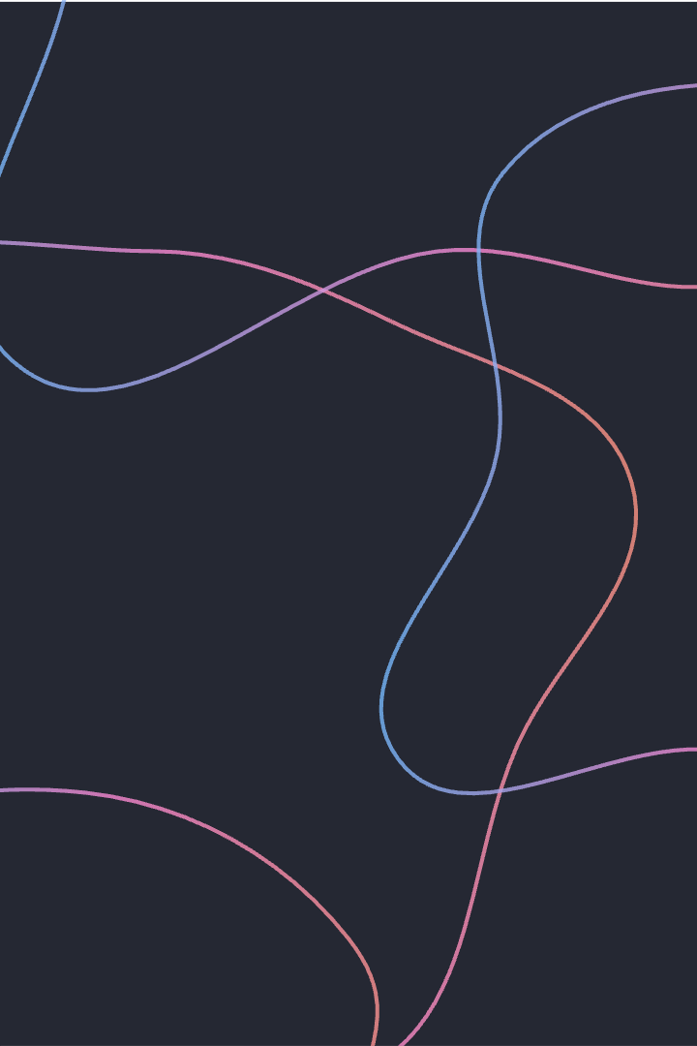




How the Program Operates
User Authentication
Register and log in; only registered users can modify posts.
Post Creation
Authenticated users submit posts with title and content.
Post Viewing
All users can view and read blog posts.
Edit/Delete Posts
Only authors or admins can edit or delete posts.

Slide 4
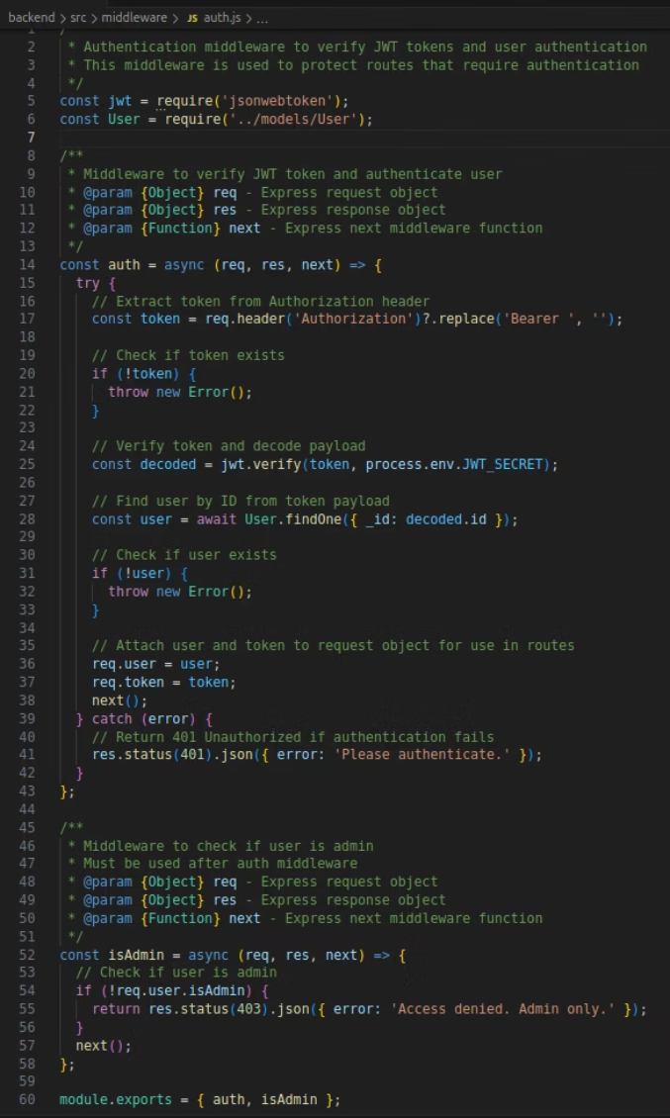
Secure User Authentication
At the heart of our secure blog application is a robust user authentication system powered by JWT (JSON Web Tokens). Let's dive into how it works:
Token Extraction
1
The middleware extracts the JWT from the Authorization header, removing the "Bearer " prefix.
2
Token Verification
The token is then verified using a secret key (process.env.JWT_SECRET) and the payload is decoded.
User Validation
3
The decoded user ID is used to find the corresponding user in the database. If no user is found, an error is thrown.
When authentication is successful, the user and token are attached to the request object (req.user and req.token) for use in subsequent routes.
Error Handling
Admin Access Control
To ensure proper access control, an additional "isAdmin" middleware checks if the authenticated user has admin privileges. If not, a 403 error is returned, denying access.

Slide 5
Powerful Post Management
Unleash the full potential of your blog with our robust post creation and management capabilities. Let's dive into the details:
Secure Authentication
1
Only authenticated users can create, update, or delete posts, thanks to our JWT-powered middleware.
2
Seamless Authorship
When a user creates a new post, they are automatically assigned as the author, ensuring content ownership.
Comprehensive Routing
3
Our Express routes cover all CRUD operations, from creating new posts to fetching and updating existing ones.
Access Control Mastery
To maintain content integrity, our isAdmin middleware ensures only authorized users (authors or admins) can edit or delete posts.
Error Handling Vigilance
With this powerful post management system, you can effortlessly create, manage, and secure your blog content, empowering your audience like never before.

Slide 6
Technologies and Environment
Development Tools
Runtime Environment
Visual Studio Code (VSCode)
Frontend: React with Tailwind CSS
GitHub for version control
Backend: Node.js for scalable apps

Slide 7

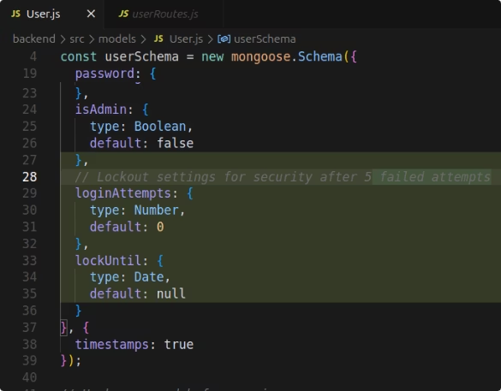

Security Features: Authentication
Brute Force Protection
Account locks after 5 failed login attempts for 15 minutes.
Password Security
Passwords are securely hashed to protect user data.
Access Control
Strict checks ensure only authorized actions are allowed.

Slide 8
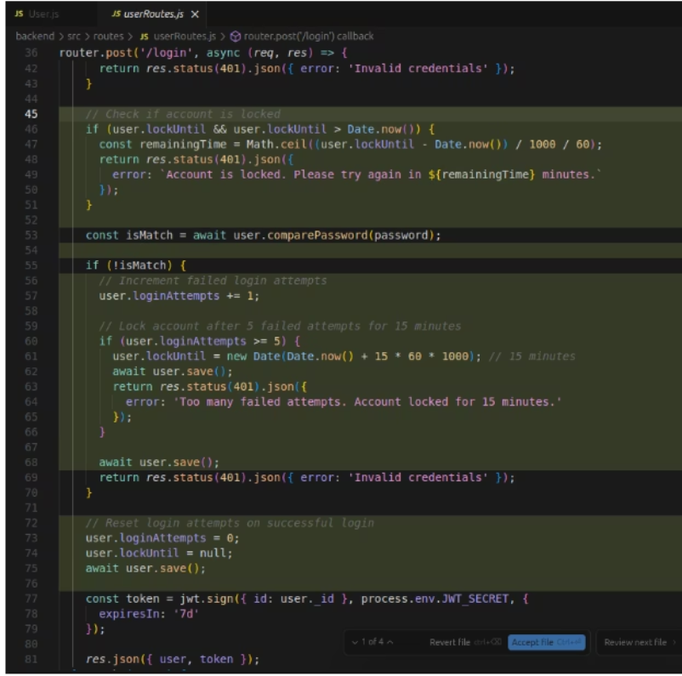
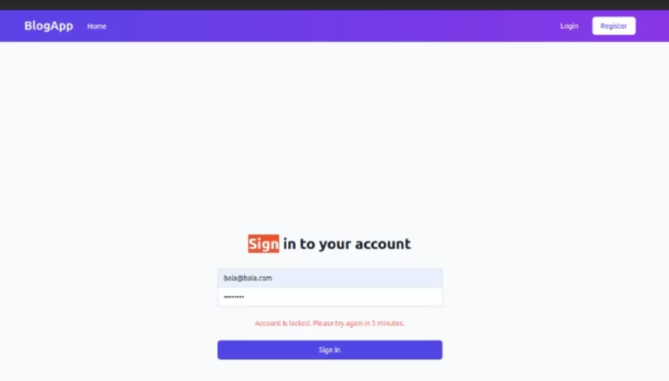
Code and Demonstration for Broken Authentication
Demonstration of account getting locked after 5 unsuccessful attempt
Code for Brute-Force protection

Slide 9

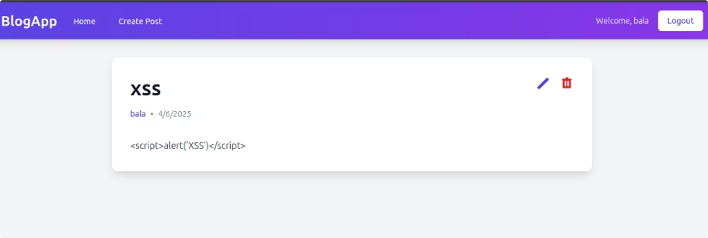
Security Features: XSS and Click-Jacking
Content Security Policy
Restricts resources to prevent XSS attacks.
X-XSS-Protection Header
Blocks reflected XSS attacks in browsers.
Stored XSS santization demonstrated

Slide 10
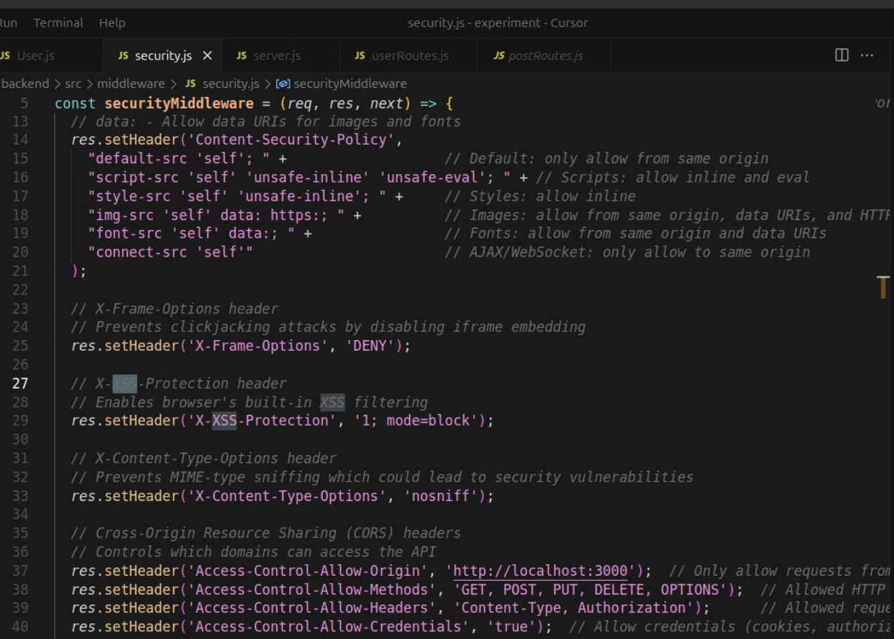
Code for Prevention of XSS and Click-Jacking

Slide 11
Vulnerabilities Tested based on OWASP Top 10
Injection Attacks
Broken Authentication
Token Validation
Token tampering
Sensitive Data Exposure
Broken Access Control
XSS and Click-Jacking
XML External Entities

Slide 12
Testing Approach and Results
Manual Testing
Outcomes
Focused on security and standard functionality.
Identified vulnerabilities addressed with lockouts and validation.
Tested brute force, token tampering, XSS and other vulnerabilities.
Authentication bypass attempts failed as intended.

Slide 13
Unimplemented Features and Potential Enhancements
Two-Factor Authentication (2FA): Planned but not completed, limited to Gmail OTPs due to complexity and cost.
Future Improvements: Expand 2FA support to include multiple authentication methods for stronger security.
Additional Features: Consider sharing blog posts and integrating advanced security tools.

Slide 14

AI Usage in Development
AI tools like ChatGPT, GROK, and Gamma refined documentation and reports.
AI did not write core logic or make security decisions.
It accelerated development and supported best practices.

